Slide 1
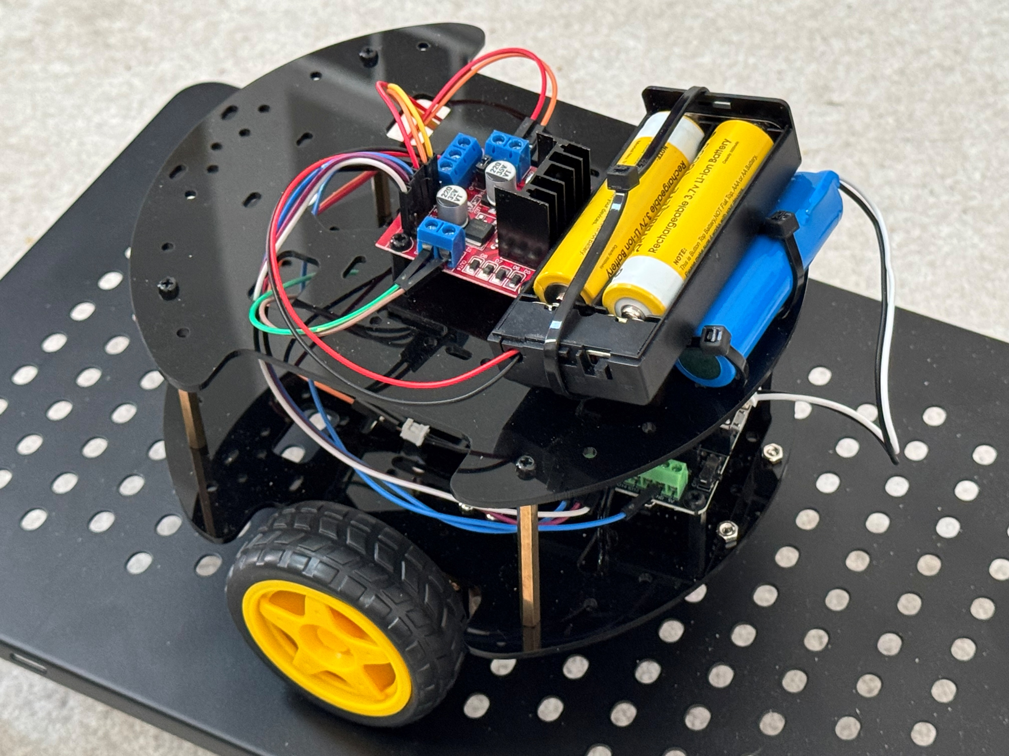

Let us make a smart phone operated differential mobile robot

Slide 2
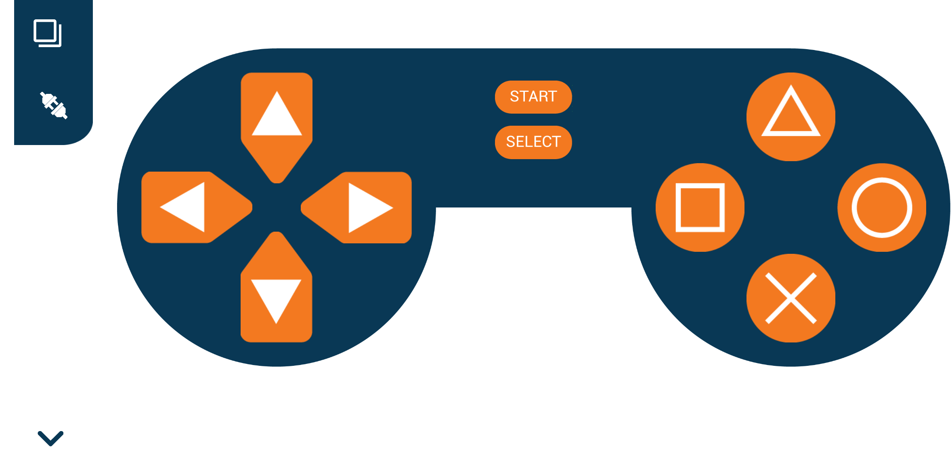
We will use the Dabble App. to teleoperate the mobile robot using Bluetooth connection

Slide 3
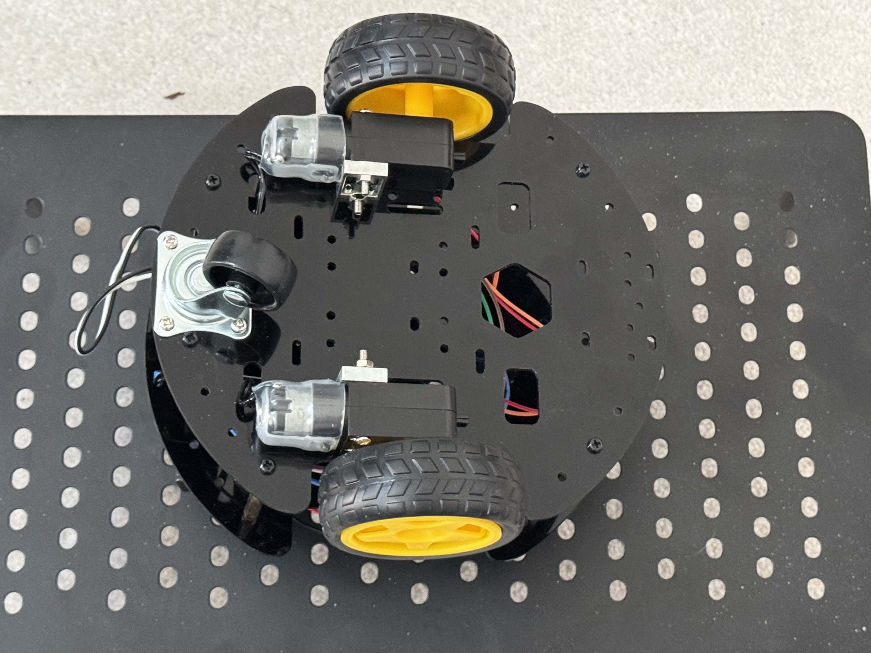
The chassis consists of circular plates, standoffs, right angled gearbox DC motors, 65 mm wheels and a swivel caster.

Slide 4
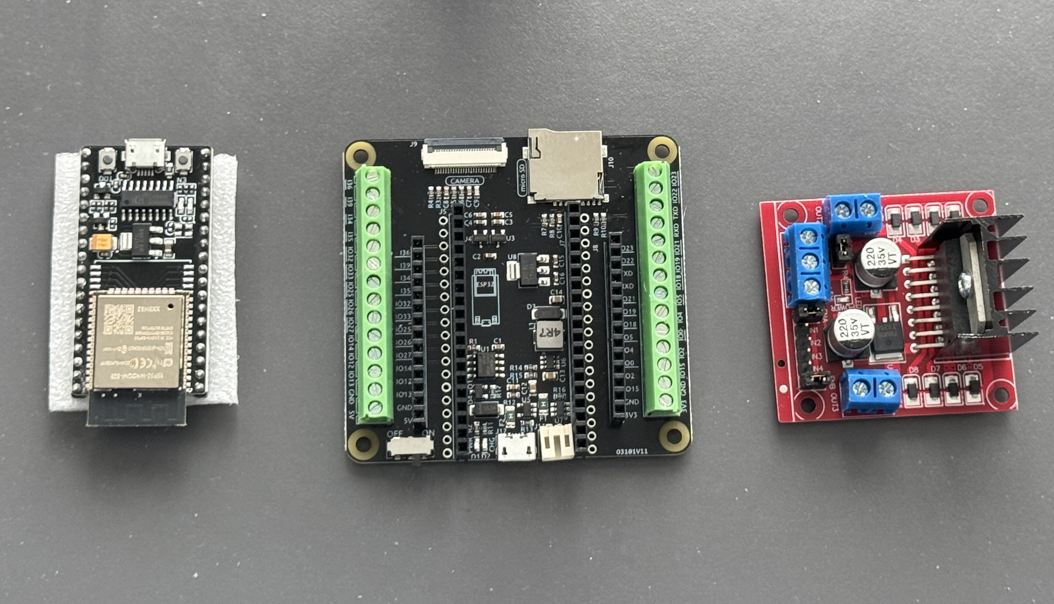
This is the Control System we will use MCU ESP32 with Bluetooth, Carrier Board & Motor Driver

Slide 5
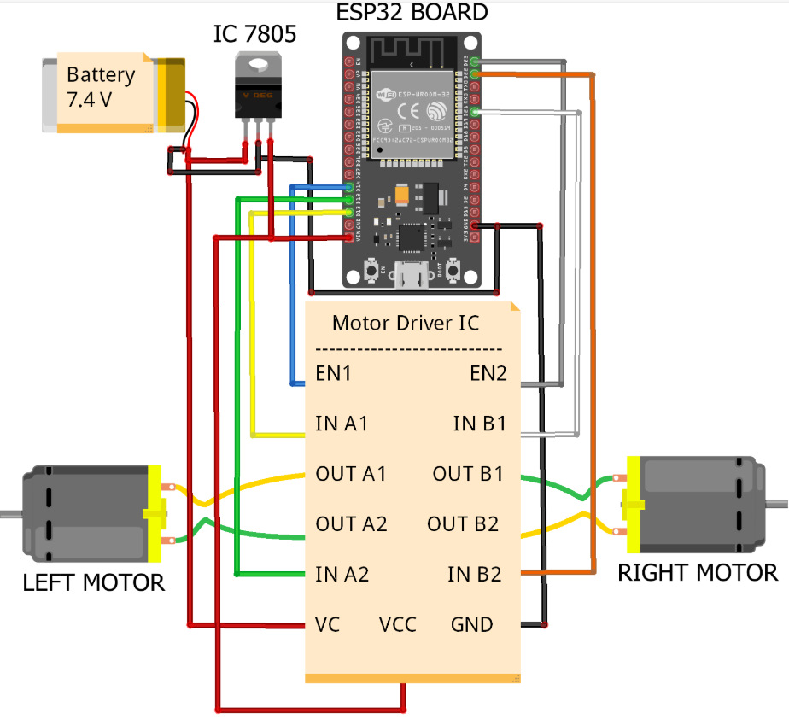
Electrical Schematic
We will need 3 digital output pins of the ESP32 for each motor.
2 pins determine direction and one pin controls the speed of rotation of the motor
We power the motors and the ESP32 with 18650 Rechargeable Batteries

Slide 6
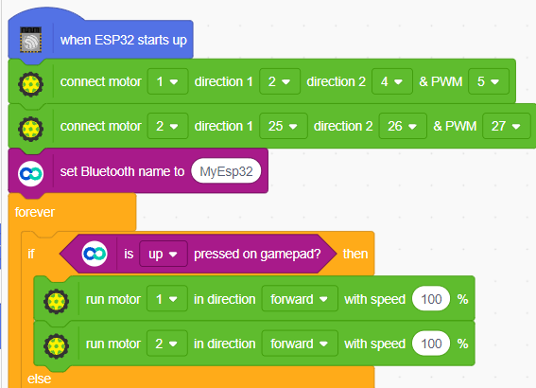
We will program the robot using PictoBlox.
PictoBlox is a graphical programming language.
Dabble is able to connect to the robot by identifying the Bluetooth name.
We use conditional statements to make the robot move based on the button pressed in the smart phone
In this example Motor 1 is using pins 2 and 4 as direction pins and pin 5 as PWM pin.

Slide 7
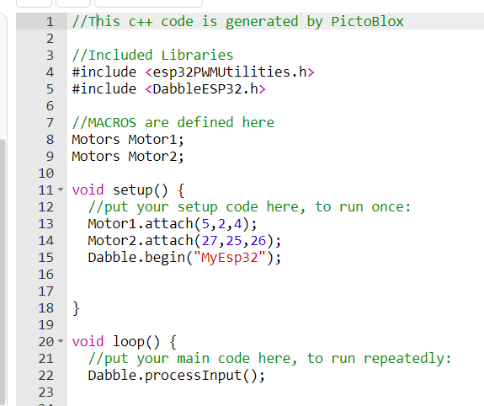
PictoBlox will automatically create Arduino code from the graphical code This feature will help you learn how to code from the Arduino IDE

Slide 8
We are teleoperating the mobile robot using the Dabble App. on our smart phone.

